Slide 1

Applications Development Practice 3 (ADP372S)
Lecturer: Kruben Naidoo
Email: NaidooK@cput.ac.za
Office: Rm 2.11 – Engineering Building, District Six Campus, Cape Town, South Africa.

Slide 2
Lesson objectives:
Welcome
Capstone group project presentations on campus
The Bridge Design Pattern
The Composite Design Pattern
The Decorator Design Pattern
The Flyweight Design Pattern
Summary
Reminder of Capstone project group consultation sessions

Slide 3
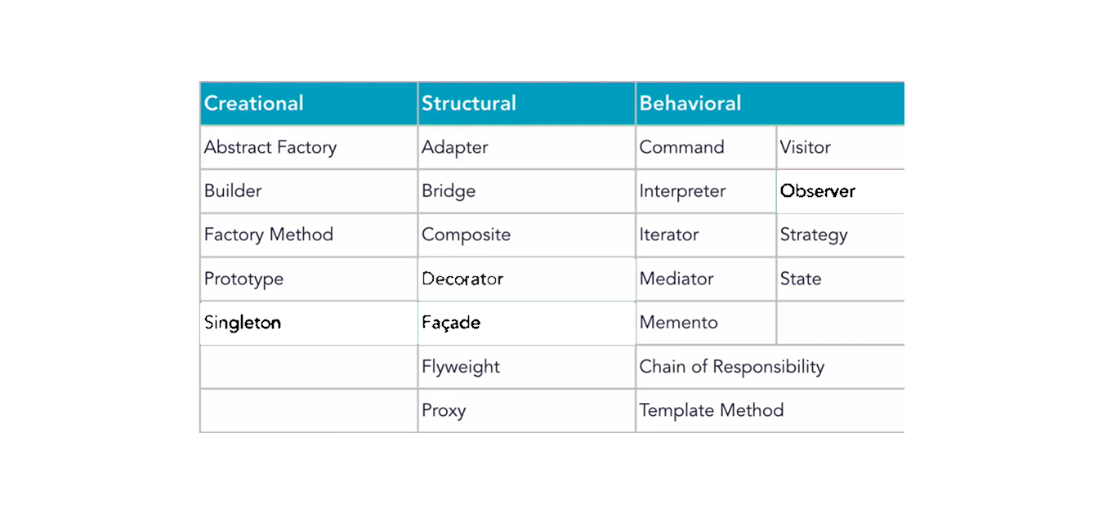
Recap
Figure: 23 Gang of Four (GOF) Patterns

Slide 4
The Bridge Design Pattern
The Bridge design pattern allows you to separate the abstraction from the implementation so that the two can vary independently.
It is a structural design pattern.

Slide 5
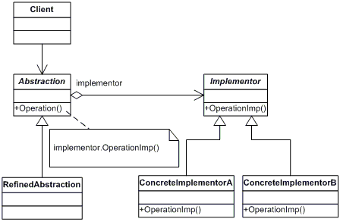
The Bridge Design Pattern

Slide 6
The Bridge Design Pattern
Watch the following video by Derek Banas
https://www.youtube.com/watch?v=9jIgSsIfh_8

Slide 7
The Composite Design Pattern
Allows you to treat individual objects and composition of objects uniformly
They allow you to represent part-whole hierarchies
Components can be further divided into smaller components
You can structure data, or represent the inner working of every part of a whole object individually.

Slide 8
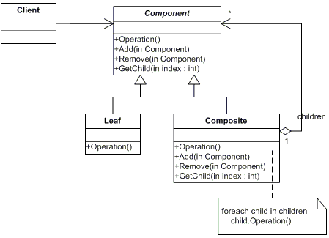
The Composite Design Pattern

Slide 9
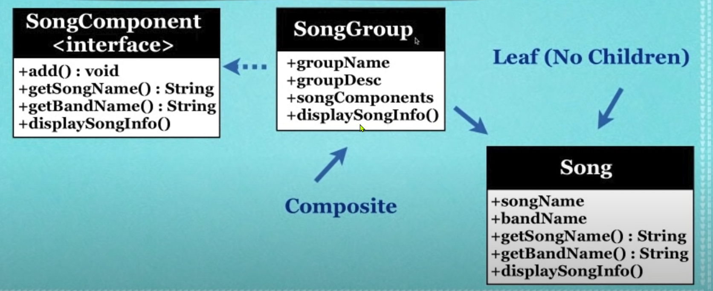
The Composite Design Pattern
Example
Let us turn to IntelliJ to review the following code example.

Slide 10
The Decorator Design Pattern
The Decorator allows you to modify an object dynamically
You would use it when you want the capabilities of inheritance with subclasses, but you need to add functionality at run-time
It is more flexible than inheritance.
Simplifies code because you add functionality using many simple classes
Rather than rewrite old code you can extend with new code

Slide 11
The Decorator Design Pattern class diagram

Slide 12
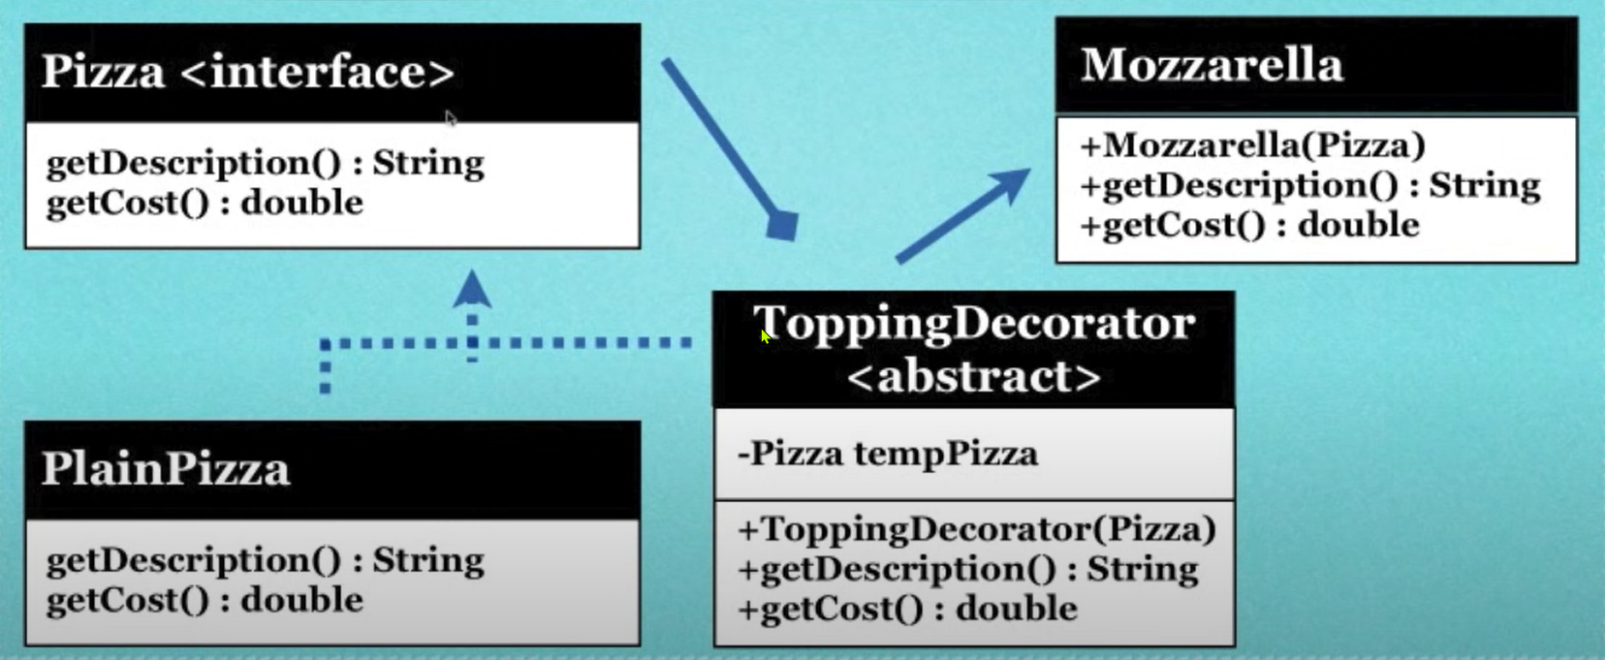
The Decorator Design Pattern Example
Let us turn to IntelliJ to look at the following Pizza example and how we implement the Decorator pattern.

Slide 13
The Flyweight Design Pattern
Used when you need to create a large number of objects
To reduce the memory usage you share Objects that are similar in some way rather than creating new ones
Let us look at an example… creating 500000 rectangles
Intrinsic State : Colour
Extrinsic State: Size

Slide 14
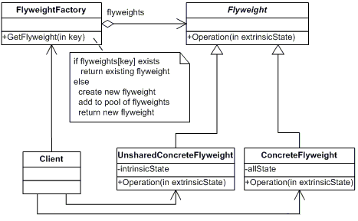
The Flyweight Design Pattern class diagram

Slide 15
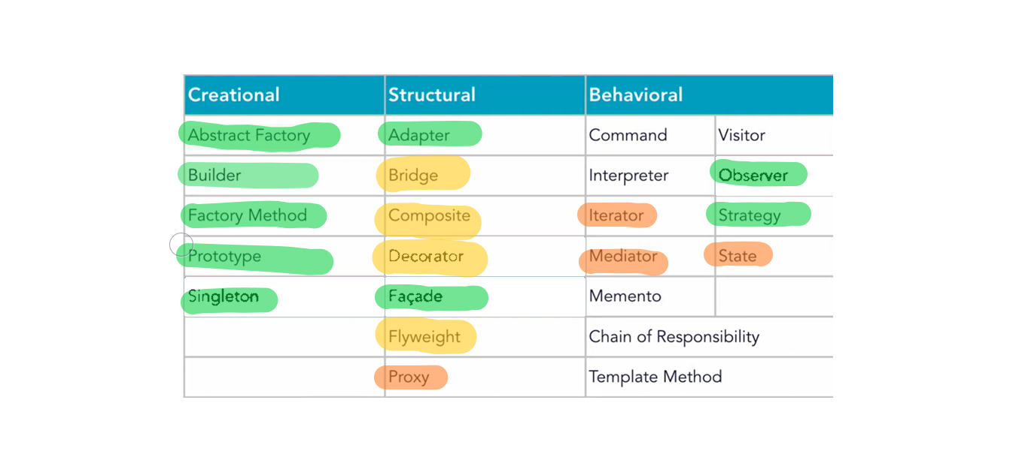
Summary
Figure: 23 Gang of Four (GOF) Patterns

Slide 16
Any questions?

